Slide 1
Study on Metro Areas and State Boundaries
Coursera Capstone Project

Slide 2
Importance of State Boundaries
State Boundaries not only denote a difference between two different states, but also two different sets of laws, two different tax codes, and two different business codes
New York, New Jersey and Connecticut’s boundaries have historically effected how the New York City Metro has formed.
Another Prime example is the Kansas City metro which is straddled between Kansas and Missouri
Several Studies done in the Kanasas City Metro have shown unequal urban development which has been detrimental to the metro area.

Slide 3
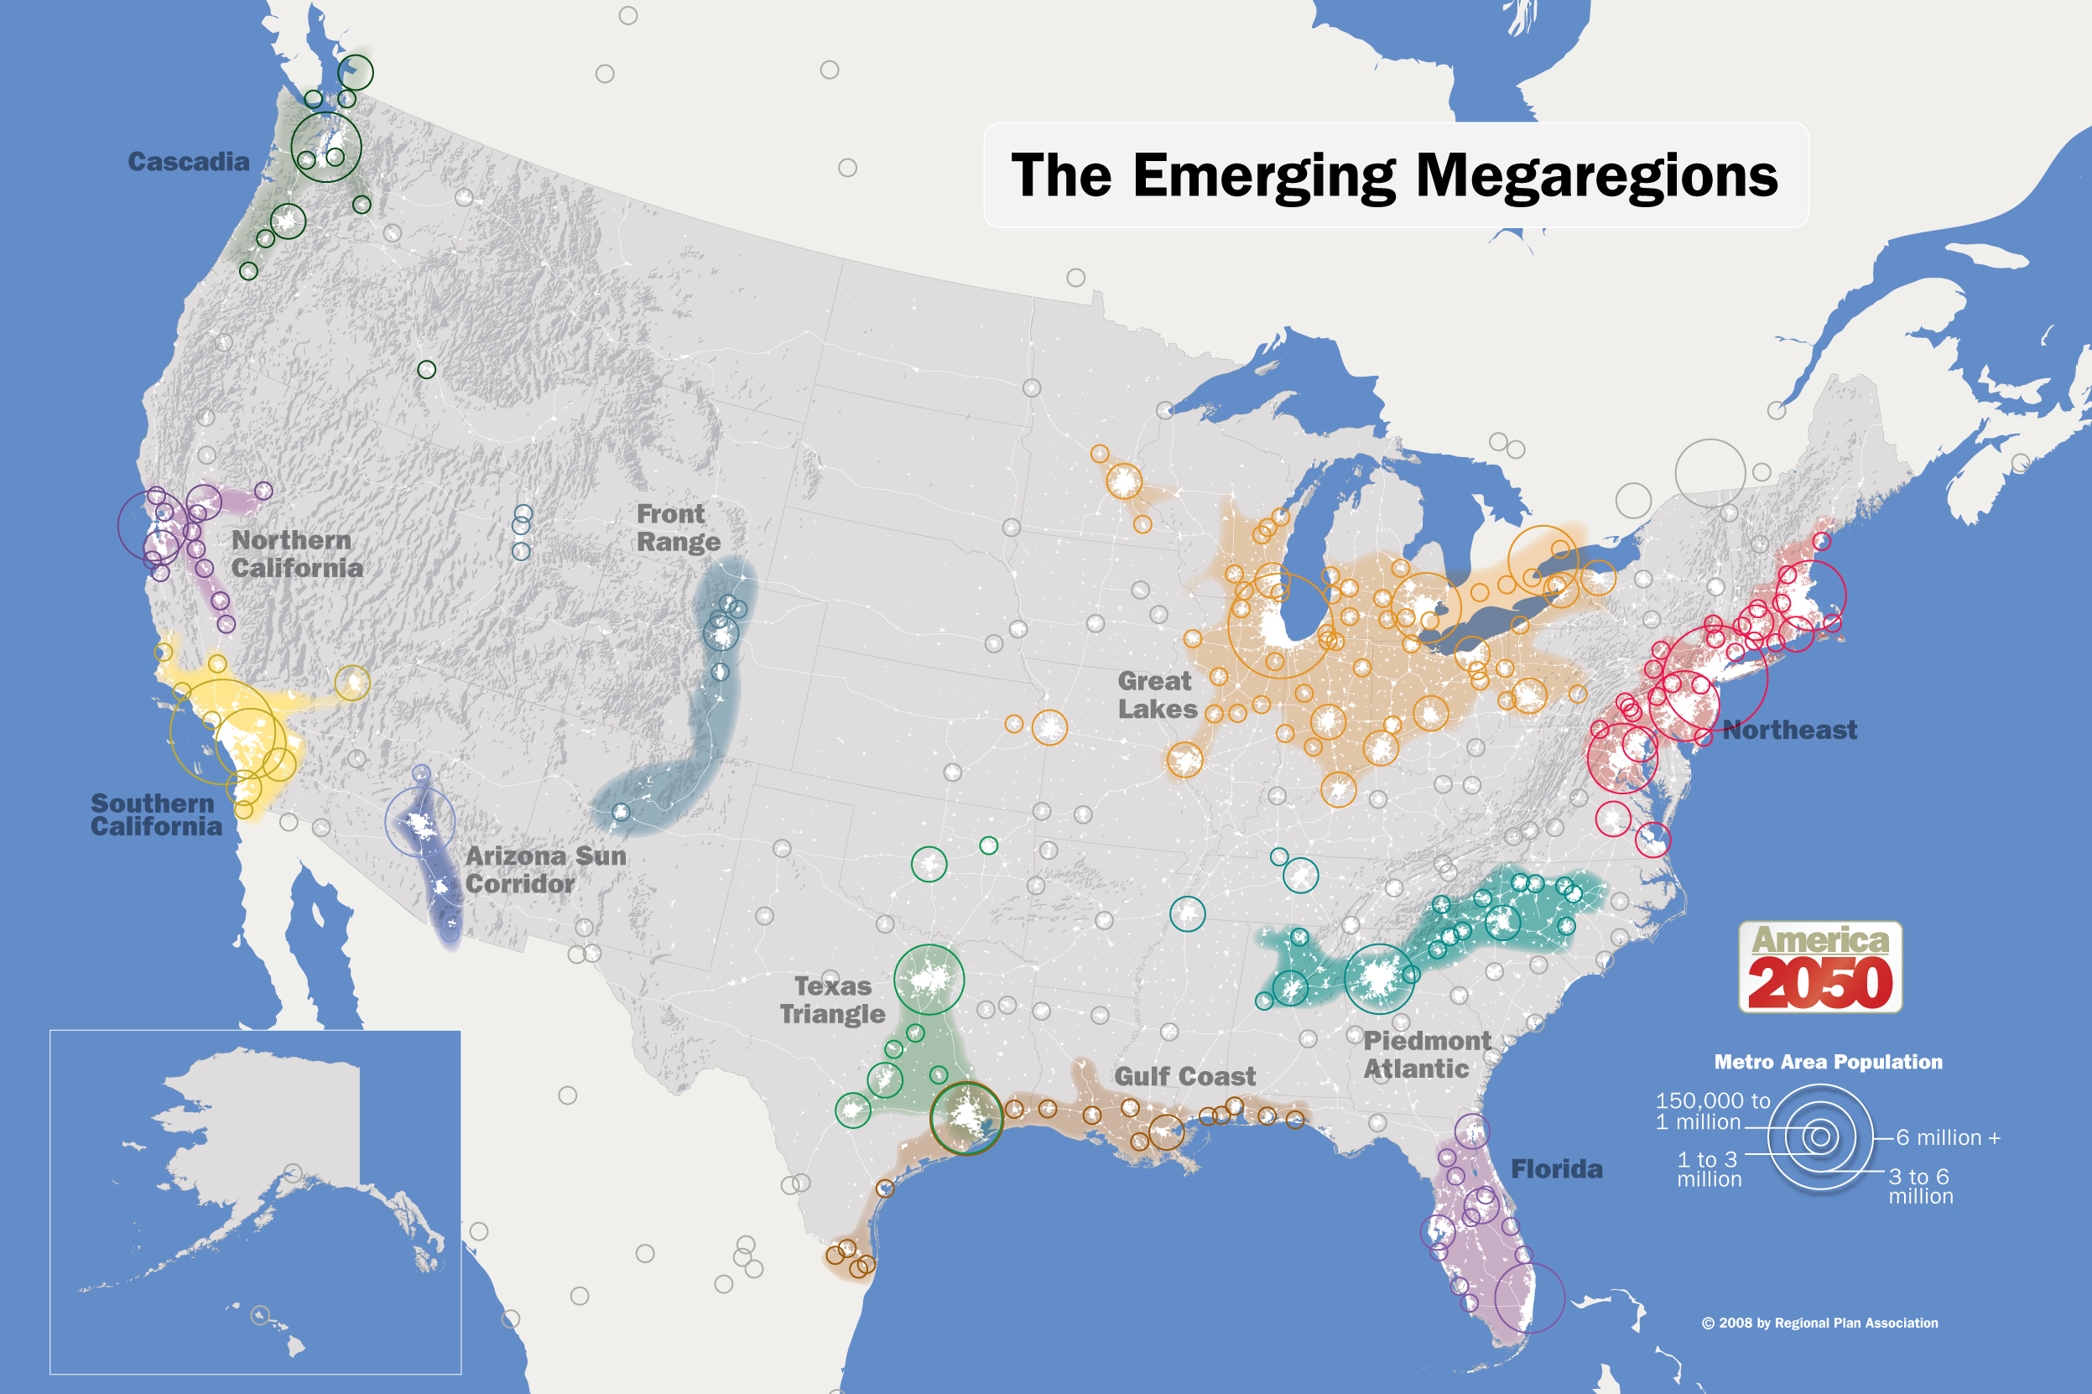
Future of Multi-State Metro Areas
As Megaregions form, state boundaries will play a more crucial role
Image from https://cdn.theatlantic.com/static/mt/assets/politics/2050_Map_Megaregions2008_150.png

Slide 4
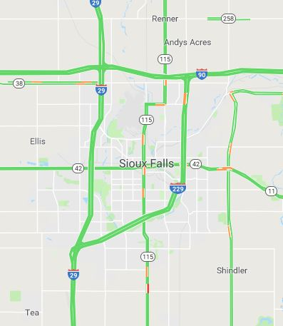
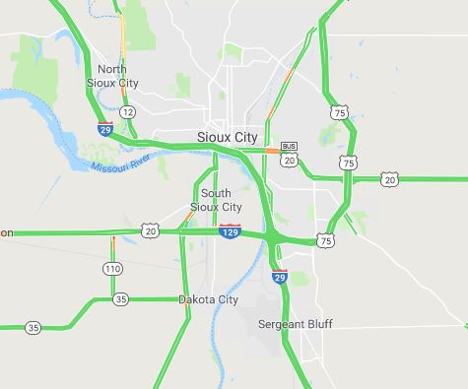
Study Regions

Slide 5
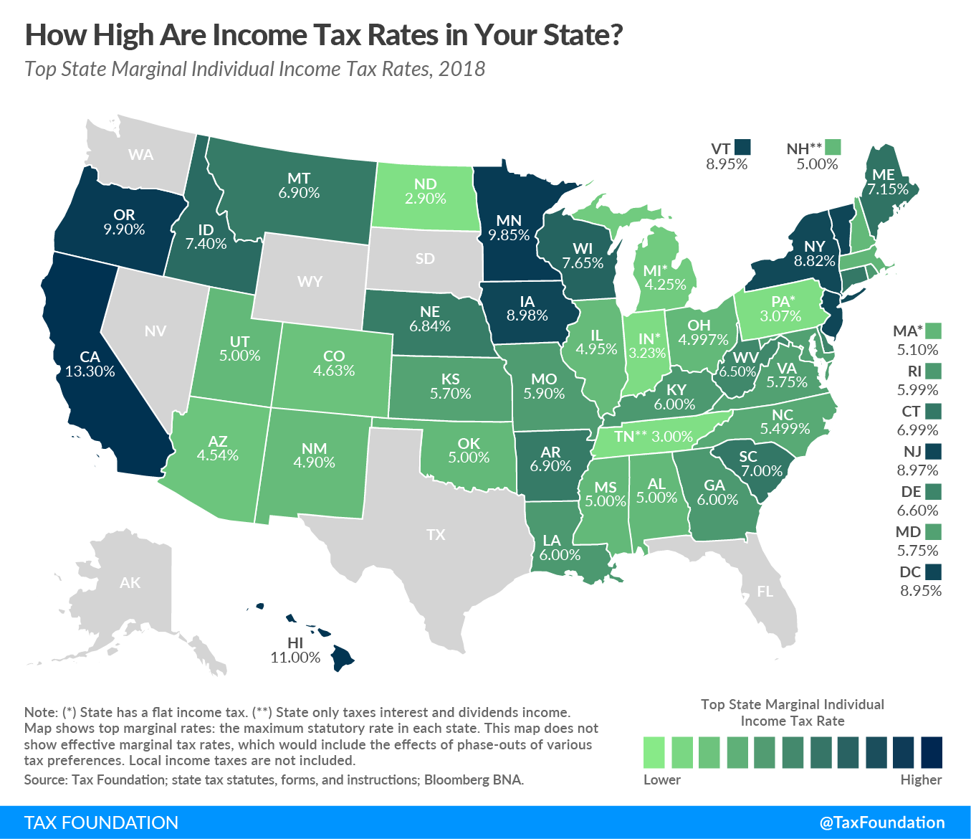
Sales Taxes
For The Sioux City Metro, this is a huge reason for the skewed development
https://taxfoundation.org/state-individual-income-tax-rates-brackets-2018/

Slide 6
Choice of Regions
Sioux Falls since in one State: South Dakota. The Sioux City Metro spread into three states: Iowa, Nebraska, and South Dakota
These two metro areas are an hour apart and have very similar cultures and industries. This was done to isolate the independent variable (State Boundaries vs No State Boundaries.)
Zip Code with the different neighborhoods and Lat Lons were used. Income was also found for each different area
Lat Lons were put into Foursquare API and the top 10 results for each venue were found
Machine learning: One Hot coding as well as K-clustering was used

Slide 7
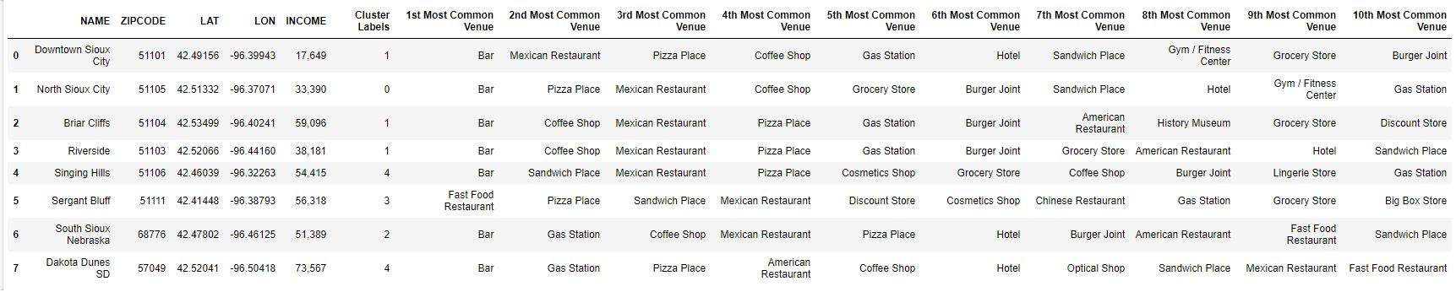
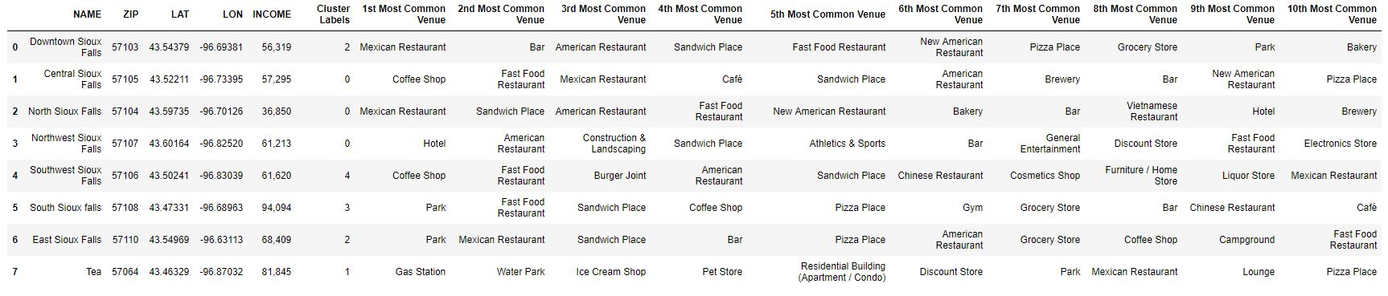
Results

Slide 8
Discussion
Looking at the data the clearly is a difference between the Tri State Sioux City Metro and the single state Sioux Falls Metro
With a grocery tax in South Dakota, Dakota Dunes mainly has gas and restaurants with Iowa having most of the grocery and retail
South Dakota has incentives on their medical industry so seeing incentives and this can be seen looking at the Optical Shop venue in the Dakota Dunes list
Bars Dominate the Sioux City Metro while Parks are the seemingly dominant feature in Sioux Falls
Sioux Falls has a greater diversity of venues by far
Income distribution is far more uniform in Sioux Falls than in Sioux City

Slide 9
Implications from the Data
Looking at the data and even looking at clustering, it is easy to see that there have several different areas tends to segment the metro area in a somewhat harmful way
Lack of community unity from an urban planning standpoint is evident in the Sioux City metro. The Sioux Falls metro is much more uniform and has more evident central vision
It is clear from the data people live in Nebraska and South Dakota and work in Iowa. This increased the need for transportation which can have other unintended consequences
Segmentation, as shown from the data leads to less diversity community venues and leads to a less uniform metro area.

Slide 10
Conclusion
Having state boundaries running through a metropolitan area can take away from urban planning cohesion and lead to large groups of segmentation which have net negative effect on the community
Urban planners and politicians alike to need to figure ways out to make special incentives to prevent the creation of bedroom community and work only communities which have a negative effect on the metro area as a whole
A proposal in the Kansas City area will make a special tax incentive to help lessen the effects and differences between state lines
The data suggests that this is needed in areas where political boundaries cross population centers

